Slide 1
Lecture 4 Memory Management
Tanenbaum, Modern Operating Systems 3 e, (c) 2008 Prentice-Hall, Inc. All rights reserved. 0-13-6006639

Slide 2
Memory Management Basics
Main memory (RAM) is an important limited resource that must be very carefully managed.
Memory hierarchy:
Cache (fast)
Main(medium)
Disk(slow)
It is the job of the operating system to abstract this hierarchy into a useful model and then manage the abstraction.
The part of the operating system that manages the memory hierarchy is called the memory manager.
memory manager: Its job is to efficiently manage memory making the following tasks:
Keep track of which parts of memory are in use
Allocate memory to processes when they need it
Deallocate it when they are done.
Tanenbaum, Modern Operating Systems 3 e, (c) 2008 Prentice-Hall, Inc. All rights reserved. 0-13-6006639

Slide 3
No memory abstraction
The simplest memory abstraction is to have no abstraction at all.
Every program simply saw the physical memory.
When a program executed an instruction like
MOV REGISTER1,1000
the computer just moved the contents of physical memory location 1000 to REGISTER1.
Can only have one program in memory at a time, it is not possible to have two running programs in memory at the same time because if the first program wrote a new value to location 2000, this would erase whatever value the second program was storing there.
Tanenbaum, Modern Operating Systems 3 e, (c) 2008 Prentice-Hall, Inc. All rights reserved. 0-13-6006639

Slide 4
No memory abstraction
One way to get some parallelism in a system with no memory abstraction is to program with multiple threads as all threads in a process are supposed to see the same memory image.
Problems:
What people often want is unrelated programs to be running at the same time, something the threads abstraction does not provide.
A system that is so primitive as to provide no memory abstraction is unlikely to provide a threads abstraction.
Tanenbaum, Modern Operating Systems 3 e, (c) 2008 Prentice-Hall, Inc. All rights reserved. 0-13-6006639

Slide 5
Running Multiple Programs Without a Memory Abstraction
Swapping: the operating system saves the entire contents of memory to a disk file, then bring in and run the next program. As long as there is only one program at a time in memory, there are no conflicts.
Not really concurrent
Tanenbaum, Modern Operating Systems 3 e, (c) 2008 Prentice-Hall, Inc. All rights reserved. 0-13-6006639

Slide 6
IBM 360
With the addition of some special hardware, it is possible to run multiple programs concurrently, even without swapping.
IBM 360 - divide memory into 2 KB blocks, and associate a 4 bit protection key held in special registers inside the CPU.
Hardware prevents program from accessing block with another protection key.
Only the operating system could change the protection keys, thus, user processes were prevented from interfering with one another and with the operating system itself.
Tanenbaum, Modern Operating Systems 3 e, (c) 2008 Prentice-Hall, Inc. All rights reserved. 0-13-6006639

Slide 7
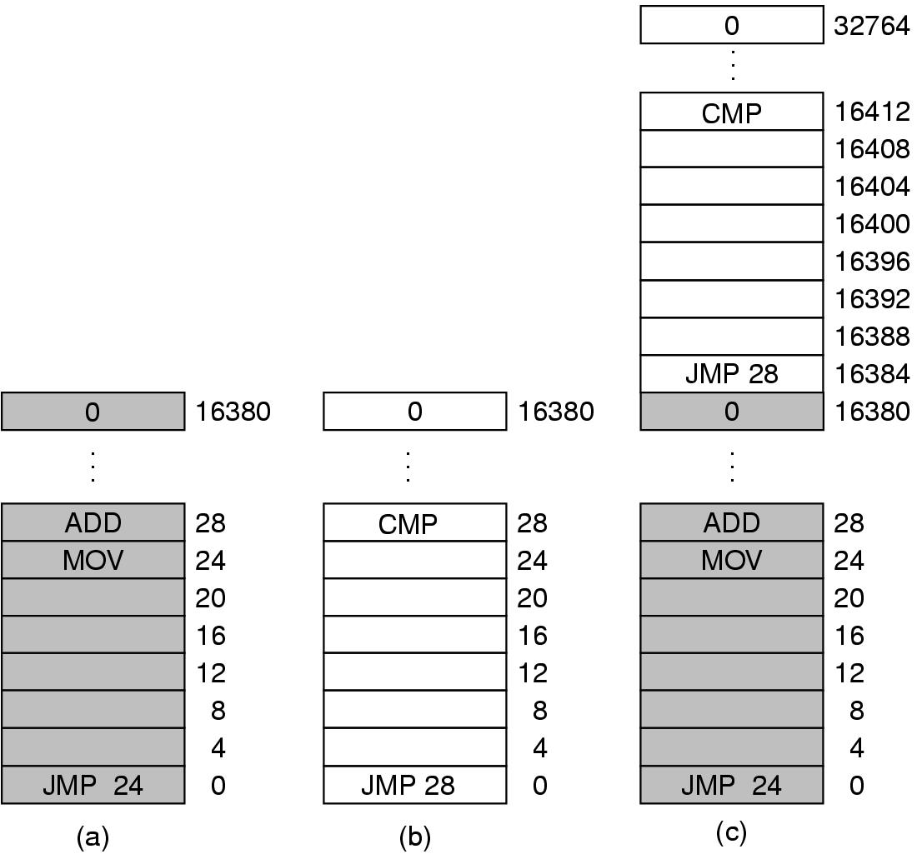
Problem with IBM 360
This solution had a major drawback, depicted in the Figure. Here we have two programs, each 16 KB in size, as shown in (a) and (b).
The first program starts out by jumping to address 24, which contains a MOV instruction.
The second program starts out by jumping to address 28, which contains a CMP instruction.
When the two programs are loaded consecutively in memory starting at address 0, we have the situation of (c).
Tanenbaum, Modern Operating Systems 3 e, (c) 2008 Prentice-Hall, Inc. All rights reserved. 0-13-6006639

Slide 8
Problem with IBM 360
When the first program starts, it executes the JMP 24 instruction, which jumps to the instruction, as expected. This program functions normally.
However, after the first program has run long enough, the operating system may decide to run the second program, which has been loaded above the first one, at address 16,384.
The first instruction executed is JMP 28, which jumps to the ADD instruction in the first program, instead of the CMP instruction it is supposed to jump to.
The program will most likely crash in well under 1 sec.
Tanenbaum, Modern Operating Systems 3 e, (c) 2008 Prentice-Hall, Inc. All rights reserved. 0-13-6006639

Slide 9
Solution: Static relocation
Problem is that both programs reference absolute physical memory.
Static relocation: load first instruction of program at address x, and add x to every subsequent address during loading
Problem:
This is too slow
it requires extra information in all executable programs to indicate which words contain (relocatable) addresses and which do not
MOV REGISTER1,28
which moves the number 28 to REGISTER1 must not be relocated. The loader needs some way to tell what is an address and what is a constant.
Tanenbaum, Modern Operating Systems 3 e, (c) 2008 Prentice-Hall, Inc. All rights reserved. 0-13-6006639

Slide 10
A memory abstraction: address spaces
On personal computers, it is common to have several programs open at once (a word processor, an email program, a Web browser), one of them having the current focus, but the others being reactivated at the click of a mouse.
Since this situation is difficult to achieve when there is no abstraction from physical memory, something had to be done.
Two problems have to be solved to allow multiple applications to be in memory at the same time without interfering with each other: protection and relocation.
An address space is the set of addresses that a process can use to address memory. Each process has its own address space, independent of those belonging to other processes: Base and Limit Registers.
Tanenbaum, Modern Operating Systems 3 e, (c) 2008 Prentice-Hall, Inc. All rights reserved. 0-13-6006639

Slide 11
Base and Limit Registers
A form of dynamic relocation
Base contains beginning address of program
Limit contains length of program
An easy way to give each process its own private address space because every memory address generated automatically has the base-register contents added to it before being sent to memory.
Program references memory, adds base address to address generated by process. Checks to see if address is larger then limit. If so, a fault is generated and the access is aborted.
Disadvantage - addition and comparison have to be done on every memory reference
Used in the CDC 6600 and the Intel 8088
Tanenbaum, Modern Operating Systems 3 e, (c) 2008 Prentice-Hall, Inc. All rights reserved. 0-13-6006639

Slide 12
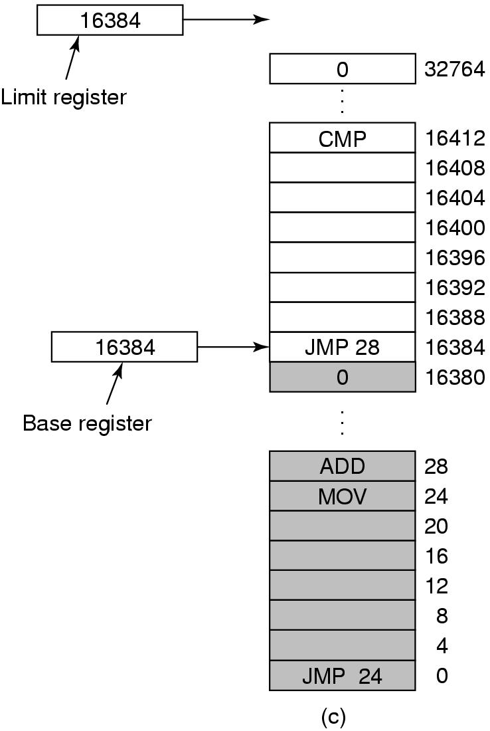
Base and Limit Registers
Add 16384 to JMP 28. Hardware adds 16384 to 28 resulting in JMP 16412
Tanenbaum, Modern Operating Systems 3 e, (c) 2008 Prentice-Hall, Inc. All rights reserved. 0-13-6006639

Slide 13
How to run more programs than fit in main memory at once
Can’t keep all processes in main memory
Too many (hundreds)
Too big (e.g. 200 MB program)
Two approaches
Swapping: bringing in each process in its entirety, running it for a while, then putting it back on the disk.
Virtual memory: allow program to run even if only part of it is in main memory
Tanenbaum, Modern Operating Systems 3 e, (c) 2008 Prentice-Hall, Inc. All rights reserved. 0-13-6006639

Slide 14
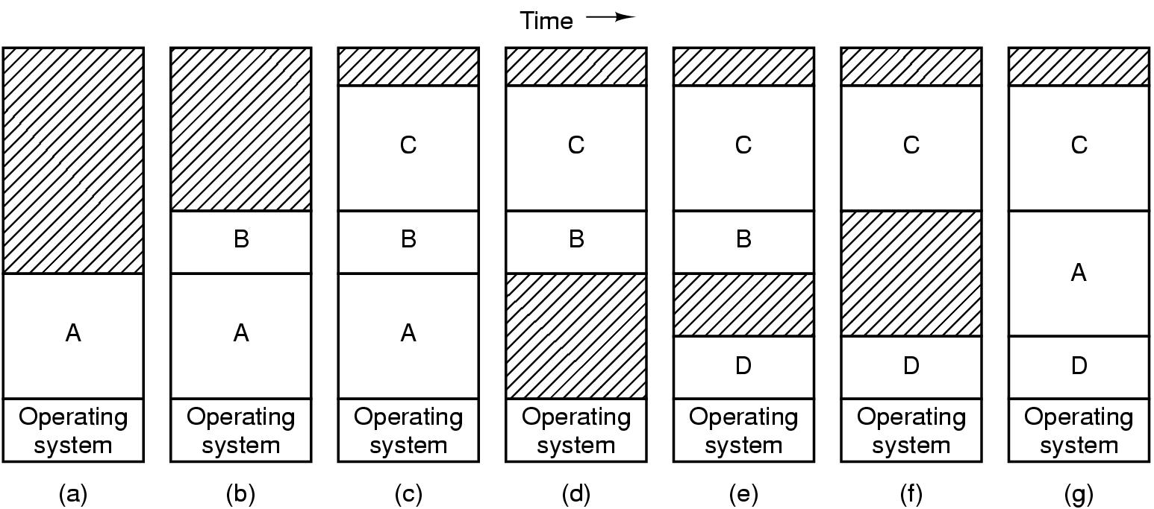
Swapping
The operation of a swapping system is illustrated in Figure. Initially, only process A is in memory. Then processes B and C are created or swapped in from disk. In (d) A is swapped out to disk. Then D comes in and B goes out. Finally A comes in again. Since A is now at a different location, addresses contained in it must be relocated. For example, base and limit registers would work fine here.
When swapping creates multiple holes in memory, it is possible to combine them all into one big one by moving all the processes downward as far as possible. This technique is known as memory compaction. It is usually not done because it requires a lot of CPU time.

Slide 15
Programs grow as they execute
If processes’ data segments can grow, for example, by dynamically allocating memory from a heap, as in many programming languages, a problem occurs whenever a process tries to grow. If a hole is adjacent to the process, it can be allocated and the process allowed to grow into the hole.
On the other hand, if the process is adjacent to another process, the growing process will either have to be moved to a hole in memory large enough for it, or one or more processes will have to be swapped out to create a large enough hole.
If a process cannot grow in memory and the swap area on the disk is full, the process will have to suspended until some space is freed up (or it can be killed).
Processes can have two growing segments:
1- Stack which holds return addresses and local variables.
2- Data segment as a heap for variables which are dynamically allocated and released
A good idea is to allocate extra memory for both from the beginning
Tanenbaum, Modern Operating Systems 3 e, (c) 2008 Prentice-Hall, Inc. All rights reserved. 0-13-6006639

Slide 16
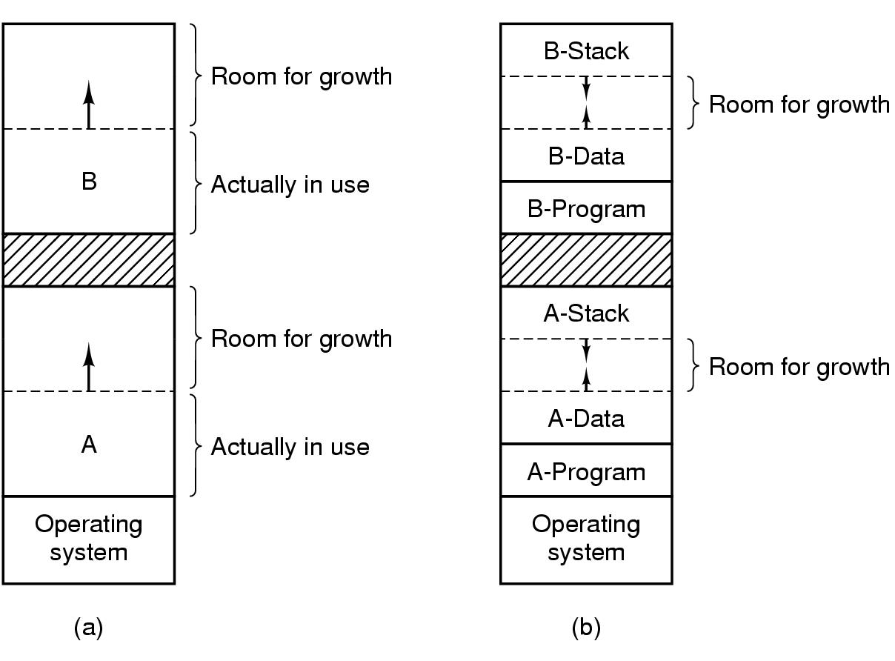
Two ways to allocate space for growth
Just add extra space
Stack grows downwards, data grows upwards
Tanenbaum, Modern Operating Systems 3 e, (c) 2008 Prentice-Hall, Inc. All rights reserved. 0-13-6006639

Slide 17
Managing Free Memory
Two techniques to keep track of free memory
Bitmaps
Linked lists
Tanenbaum, Modern Operating Systems 3 e, (c) 2008 Prentice-Hall, Inc. All rights reserved. 0-13-6006639

Slide 18
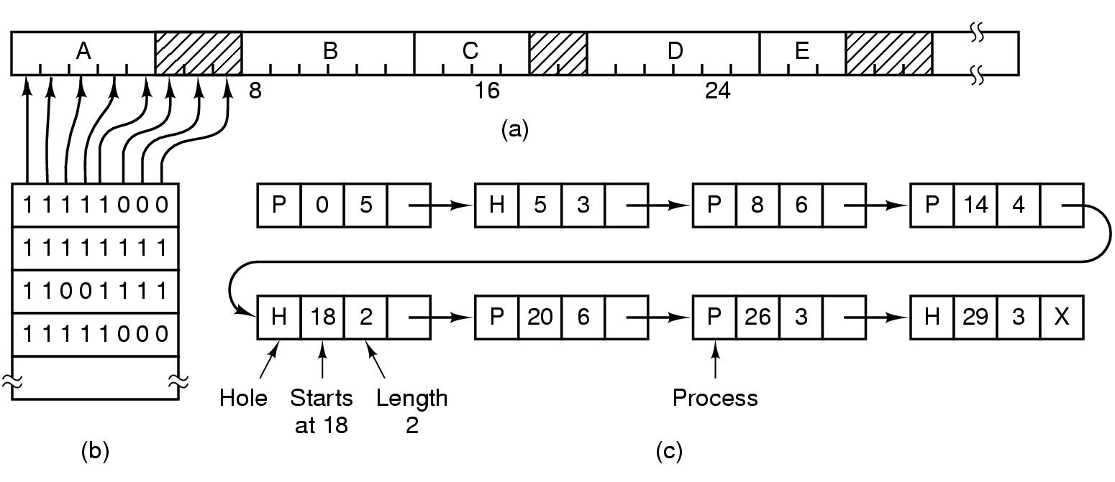
Bitmaps & Linked Lists
(a)Picture of memory
(b)Each bit in bitmap corresponds to a unit of storage (e.g. bytes) in memory
(c) Linked list P: process H: hole
Tanenbaum, Modern Operating Systems 3 e, (c) 2008 Prentice-Hall, Inc. All rights reserved. 0-13-6006639

Slide 19
Bitmaps
With a bitmap, memory is divided into allocation units. Corresponding to each allocation unit is a bit in the bitmap, which is 0 if the unit is free and 1 if it is occupied (or vice versa).
Units can be bits or bytes or…….
The smaller the allocation unit, the larger the bitmap.
Advantages: Simple way to keep track of memory
Disadvantages: need to search memory for k consecutive zeros to bring in a file k units long which is a slow operation.
Tanenbaum, Modern Operating Systems 3 e, (c) 2008 Prentice-Hall, Inc. All rights reserved. 0-13-6006639

Slide 20
Linked Lists
Another way of keeping track of memory is to maintain a linked list of allocated and free memory segments, where a segment either contains a process or is an empty hole between two processes. Each entry in the list specifies a hole (H) or process (P), the address at which it starts, the length, and a pointer to the next item.
Advantages: when a process terminates or is swapped out, updating the list is straightforward.
Tanenbaum, Modern Operating Systems 3 e, (c) 2008 Prentice-Hall, Inc. All rights reserved. 0-13-6006639

Slide 21
Algorithms to fill in the holes in memory
First fit
Next fit
Best fit
Worst fit
Quick fit

Slide 22
First fit: The memory manager scans along the list of segments until it finds a hole that is big enough. The hole is then broken up into two pieces, one for the process and one for the unused memory, except in the case of an exact fit.
Fast algorithm because it searches as little as possible
Next fit: It works the same way as first fit, except that it keeps track of where it is whenever it finds a suitable hole. The next time it is called to find a hole, it starts searching the list from the place where it left off last time, instead of always at the beginning, as first fit does.
Slightly worse than first fit
Best fit: It searches the entire list, from beginning to end, and takes the smallest hole that is adequate. Best fit is slower than first fit because it must search the entire list. It also results in more wasted memory than first fit or next fit because it tends to fill up memory with tiny, useless holes.
Worst fit: Always take the largest available hole big enough to be useful
Not good (simulation results)
Quick fit: keeps a separate list of common sizes requested. For example, it might have a table, in which the first entry is a pointer to a list of 4-KB holes, the second entry is a pointer to a list of 8-KB holes, and so on.
Extremely fast, but when a process terminates or is swapped out, finding its neighbors to see if a merge with them is possible is quite expensive.

